Slide 1


Slide 2
Section 5
GitHub and Git
in Practice

Slide 3


Section 5 - GitHub and Git in Practice
It’s our last Section! ToSection we’ll shift our focus more towards GitHub, understanding workflow patterns using Git and features specific to GitHub.

Slide 4
Section 5 - GitHub and Git in Practice
Section 5 Topics Overview:
Using git stash
Push and Pull and Git Remote Review
Common Workflow Patterns
GitHub Repository Tour
GitHub Pull Requests
Forking on GitHub
GitHub Actions

Slide 5
Let’s get started!

Slide 6
Section 5
Git Stash

Slide 7
Section 5 - GitHub and Git in Practice
Let’s discuss why and how to use the git stash command.

Slide 8
Section 5 - GitHub and Git in Practice
Git stash
Temporarily shelves (or stashes) changes you've made to your working copy so you can work on something else, and then come back and re-apply them later on.
Stashing is useful when you find yourself needing to quickly switch branches to work on something else, but are in the middle of changing a file.

Slide 9
Section 5 - GitHub and Git in Practice
Master
vh2n38
f6e2g4
zf3h49k
d34v8fh
Other
HEAD

Slide 10
Section 5 - GitHub and Git in Practice
Working on Files
Master
vh2n38
f6e2g4
zf3h49k
d34v8fh
Other
HEAD

Slide 11
Section 5 - GitHub and Git in Practice
git switch master
Master
HEAD
vh2n38
f6e2g4
zf3h49k
d34v8fh
Other

Slide 12
Section 5 - GitHub and Git in Practice
But what happens when you had changes?
Master
HEAD
vh2n38
f6e2g4
zf3h49k
d34v8fh
Other

Slide 13
Section 5 - GitHub and Git in Practice
Working on Files
Master
vh2n38
f6e2g4
zf3h49k
d34v8fh
Other
HEAD

Slide 14
Section 5 - GitHub and Git in Practice
Created new non-conflict files on Other
Master
vh2n38
f6e2g4
zf3h49k
d34v8fh
Other
HEAD

Slide 15
Section 5 - GitHub and Git in Practice
You have also not even committed them…
Master
vh2n38
f6e2g4
zf3h49k
d34v8fh
Other
HEAD

Slide 16
Section 5 - GitHub and Git in Practice
If you switch over with git switch master…
Master
HEAD
vh2n38
f6e2g4
zf3h49k
d34v8fh
Other

Slide 17
Section 5 - GitHub and Git in Practice
Non-conflict files/changes come too!
Master
HEAD
vh2n38
f6e2g4
zf3h49k
d34v8fh
Other

Slide 18
Section 5 - GitHub and Git in Practice
Or if you have a conflicting change
Master
vh2n38
f6e2g4
zf3h49k
d34v8fh
Other
HEAD

Slide 19
Section 5 - GitHub and Git in Practice
Or if you have a conflicting change
Master
vh2n38
f6e2g4
zf3h49k
d34v8fh
Other
HEAD

Slide 20
Section 5 - GitHub and Git in Practice
Or if you have a conflicting change
error: Your local changes to the following files would be overwritten by checkout:
myfile.txt
Please commit your changes or stash them before you switch branches.
Aborting
Master
vh2n38
f6e2g4
zf3h49k
d34v8fh
Other
HEAD

Slide 21
Section 5 - GitHub and Git in Practice
We can stash our changes to preserve them!
error: Your local changes to the following files would be overwritten by checkout:
myfile.txt
Please commit your changes or stash them before you switch branches.
Aborting
Master
vh2n38
f6e2g4
zf3h49k
d34v8fh
Other
HEAD

Slide 22
Section 5 - GitHub and Git in Practice
You can stash changes without a commit
Master
vh2n38
f6e2g4
zf3h49k
d34v8fh
Other
HEAD

Slide 23
Section 5 - GitHub and Git in Practice
git stash
Master
vh2n38
f6e2g4
zf3h49k
d34v8fh
Other
HEAD

Slide 24
Section 5 - GitHub and Git in Practice
git switch master
Master
HEAD
vh2n38
f6e2g4
zf3h49k
d34v8fh
Other

Slide 25
Section 5 - GitHub and Git in Practice
git switch other
Master
vh2n38
f6e2g4
zf3h49k
d34v8fh
Other
HEAD

Slide 26
Section 5 - GitHub and Git in Practice
git stash pop
Master
vh2n38
f6e2g4
zf3h49k
d34v8fh
Other
HEAD

Slide 27
Section 5 - GitHub and Git in Practice
git switch other
Master
vh2n38
f6e2g4
zf3h49k
d34v8fh
Other
HEAD

Slide 28
Section 5 - GitHub and Git in Practice
git stash apply
Master
vh2n38
f6e2g4
zf3h49k
d34v8fh
Other
HEAD

Slide 29
Section 5 - GitHub and Git in Practice
Useful if you want to apply the same stashed changes to multiple branches.
Master
vh2n38
f6e2g4
zf3h49k
d34v8fh
Other
HEAD

Slide 30
Section 5 - GitHub and Git in Practice
Note that by default Git won’t stash changes made to untracked or ignored files.
Let’s explore git stash in practice!

Slide 31
Section 5
GitHub
Push and Pull Review

Slide 32
Section 5 - GitHub and Git in Practice
Recall our Section 2 discussions of GitHub repositories as a “remote”.
Let’s clarify what git remote is more formally:
The git remote command lets you create, view, and delete connections to other repositories. Remote connections are more like bookmarks rather than direct links into other repositories.

Slide 33
Section 5 - GitHub and Git in Practice
The remote is a URL where the host repository lives, such as a GitHub URL.
As we’ve seen before, in some cases that URL is hidden (private repository) or requires permissions to directly access and interact with (PAT).
You can also have multiple git remote configurations.

Slide 34
Section 5 - GitHub and Git in Practice
Running just git remote will list the remote connections you have.
Running git remote -v will list the remote connections along with their URL.
We can add or remove remote repositories with the commands:
git remote add <name> <url>
git remote rm <name>

Slide 35
Section 5 - GitHub and Git in Practice
When working with a remote repository such as GitHub, we often have files that we don’t want to track or push, such as a SQL database which already tracks its own changes or secret files like API tokens.
The .gitignore file is a file we can create to tell Git to ignore certain files or even entire directories.

Slide 36
Section 5 - GitHub and Git in Practice
Creating a file called .gitignore at the root of the Git repository, and then you can define patterns to ignore:
Mypasswords.txt
Ignores this specific file
directory_name/
Ignores everything in this directory
*.sql
Ignores anything ending with .sql

Slide 37
Section 5 - GitHub and Git in Practice
Let’s create a new GitHub Repository, connected it to our local machine, add some files, and then use .gitignore to tell Git which files to ignore.
Then we’ll push changes and confirm that Git did not track those files meaning it also did not push them to the remote repository.

Slide 38
Section 5 - GitHub and Git in Practice
Note, we’ll also explore the push/pull using the GitHub Desktop tool, but you can always review our discussion from Section 2 on running this at the command line.

Slide 39
Section 5
Common Workflow Patterns

Slide 40
Section 5 - GitHub and Git in Practice
Common Workflow Patterns
Single Branch Workflow
Branch Based Development

Slide 41
Section 5 - GitHub and Git in Practice
Single Branch Workflow

Slide 42
Section 5 - GitHub and Git in Practice
Single Branch Workflow
Sometimes a common workflow for beginners, a single branch just does all the work on the master branch, using push and pull requests to update code on the main branch.

Slide 43
Section 5 - GitHub and Git in Practice
Single Branch Workflow
This essentially treats Git as more of a save tool or online backup than a fully featured version control system with branching ability.
Let’s take a look at the workflow and then discuss its drawbacks…

Slide 44


Section 5 - GitHub and Git in Practice
Single Branch Workflow

Slide 45
Section 5 - GitHub and Git in Practice
Single Branch Workflow

Slide 46
Section 5 - GitHub and Git in Practice
Single Branch Workflow
git push

Slide 47
Section 5 - GitHub and Git in Practice
Single Branch Workflow
git push

Slide 48
Section 5 - GitHub and Git in Practice
Single Branch Workflow
git pull

Slide 49
Section 5 - GitHub and Git in Practice
Single Branch Workflow
git pull

Slide 50
Section 5 - GitHub and Git in Practice
Single Branch Workflow

Slide 51
Section 5 - GitHub and Git in Practice
Single Branch Workflow
git push

Slide 52
Section 5 - GitHub and Git in Practice
Single Branch Workflow
git push

Slide 53
Section 5 - GitHub and Git in Practice
Single Branch Workflow
Pros:
Very simple workflow, never need to worry about other branches, conflicts, or merges.
Could work well for code systems that don’t require a lot of testing and are non-consumer facing.

Slide 54
Section 5 - GitHub and Git in Practice
Single Branch Workflow
Cons:
Becomes almost impossible to maintain a proper workflow with team members, everyone would need to run git pull and merge the master branch changes before pushing their own commits.

Slide 55
Section 5 - GitHub and Git in Practice
Single Branch Workflow
Cons:
Even for solo developers, what happens when you want to try out experimental features?
You would still need to commit them to the master branch, potentially introducing breaking updates!

Slide 56
Section 5 - GitHub and Git in Practice
Branch Based Development

Slide 57
Section 5 - GitHub and Git in Practice
Branch Based Development
The master/main branch is never worked on directly.
All new development and features are worked on separate branches, and then if collaboration is needed, the branches are also pushed to the remote repository.

Slide 58
Section 5 - GitHub and Git in Practice
Branch Based Development
The master/main branch serves as a “source of truth” and usually has procedures for merging branches back into the main branch, for example creating tests for the new features of the branch and passing historically created tests.

Slide 59
Section 5 - GitHub and Git in Practice
Branch Based Development

Slide 60
Section 5 - GitHub and Git in Practice
Branch Based Development

Slide 61
Section 5 - GitHub and Git in Practice
Branch Based Development

Slide 62
Section 5 - GitHub and Git in Practice
Branch Based Development
git push

Slide 63
Section 5 - GitHub and Git in Practice
Branch Based Development
git pull

Slide 64
Section 5 - GitHub and Git in Practice
Branch Based Development

Slide 65
Section 5 - GitHub and Git in Practice
Branch Based Development
git push

Slide 66
Section 5 - GitHub and Git in Practice
Branch Based Development
Pros:
Allows for multiple collaborators to work on the same codebase and develop new features together at the same time.
Allows for an infinite number of experiments and features (within reasonable limits).

Slide 67
Section 5 - GitHub and Git in Practice
Branch Based Development
Cons:
Needs a defined process in place to accept merges into the main/master branch.
Fortunately, we will later learn about pull requests as a way to manage these merges.

Slide 68
Section 5 - GitHub and Git in Practice
Before we dive into how to merge branch based developments, let’s have a quick tour of a GitHub repository!

Slide 69
Section 5
GitHub Repository Tour

Slide 70
Section 5 - GitHub and Git in Practice
Let’s have a very brief tour of the variety of features on a GitHub repository.

Slide 71
Section 5
GitHub Pull Requests

Slide 72
Section 5 - GitHub and Git in Practice
GitHub Pull Requests
Pull requests are a service feature of GitHub and is actually not native to Git (competing platforms also provide pull request features).
They allow for an organized review of new merges into a branch.

Slide 73
Section 5 - GitHub and Git in Practice
GitHub Pull Requests
Code review processes will vary between organizations, but pull requests are often the foundation of the code review process.
GitHub has the ability to give different levels of permissions for approving pull requests or allowing a merge.

Slide 74
Section 5 - GitHub and Git in Practice
GitHub Pull Requests
Let’s review real pull requests on open-sourced projects and then get some practice with our own pull request!

Slide 75
Section 5
Forking on GitHub

Slide 76
Section 5 - GitHub and Git in Practice
Now that we understand pull requests, let’s explore the workflow of using a “fork” which is a GitHub feature, creating a copy of a repository on GitHub for your own GitHub account.
Then you can clone that version locally, make changes, and create pull requests to merge those changes.

Slide 77
Section 5 - GitHub and Git in Practice
Forking only creates the copy on your GitHub, you then need to clone this copy to your local machine, make updates/changes, and then create the pull request.
Any changes you push to GitHub would only get pushed onto your own copy of the repository.

Slide 78
Section 5 - GitHub and Git in Practice
Original Repository
Original Repository

Slide 79
Section 5 - GitHub and Git in Practice
Fork a copy on GitHub
Forked Repository
Original Repository

Slide 80
Section 5 - GitHub and Git in Practice
Clone your forked copy locally
Forked Repository
Original Repository
Local

Slide 81
Section 5 - GitHub and Git in Practice
Set up your remote origin
Forked Repository
Original Repository
ORIGIN
Local

Slide 82
Section 5 - GitHub and Git in Practice
And set up your remote upstream
Forked Repository
Original Repository
ORIGIN
UPSTREAM
Local

Slide 83
Section 5 - GitHub and Git in Practice
Upstream allows you to update locally
Forked Repository
Original Repository
ORIGIN
UPSTREAM
Local

Slide 84
Section 5 - GitHub and Git in Practice
Update from upstream remote
Forked Repository
Original Repository
ORIGIN
UPSTREAM
Local

Slide 85
Section 5 - GitHub and Git in Practice
Now work on changes locally
Forked Repository
Original Repository
Local

Slide 86
Section 5 - GitHub and Git in Practice
Push to origin
Forked Repository
Original Repository
git push
Local

Slide 87
Section 5 - GitHub and Git in Practice
Submit Pull Request on GitHub
Pull request
Forked Repository
Original Repository
Local

Slide 88
Section 5 - GitHub and Git in Practice
Owner can decide to merge or not
Pull request
Forked Repository
Original Repository
Local

Slide 89
Section 5 - GitHub and Git in Practice
Can accept changes
Pull request
Forked Repository
Original Repository
Local

Slide 90
Section 5 - GitHub and Git in Practice
Let’s see an example of this!

Slide 91
Section 5
GitHub Actions

Slide 92
Section 5 - GitHub and Git in Practice
GitHub Actions is a continuous integration and continuous delivery (CI/CD) platform that allows you to automate your build, test, and deployment pipeline.
You can create workflows that build and test every pull request to your repository, or deploy merged pull requests to production.

Slide 93
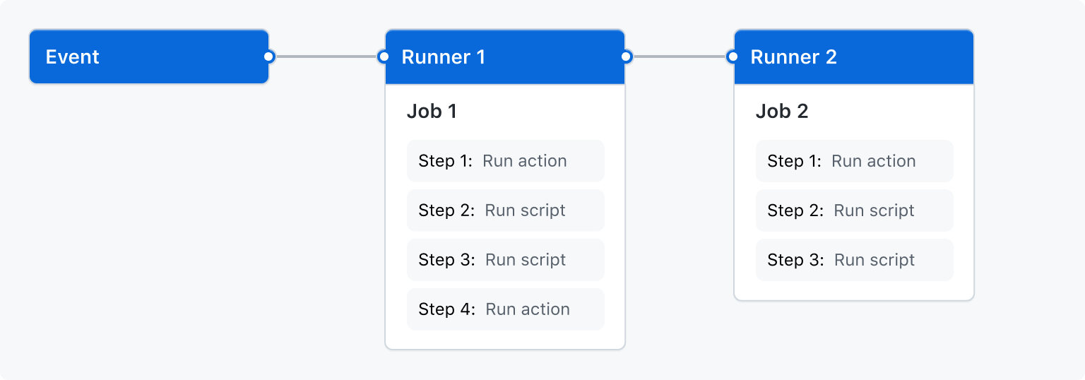
Section 5 - GitHub and Git in Practice
GitHub Actions are executed upon an event, and the “runners” of jobs can be stacked on top of each other:

Slide 94
Section 5 - GitHub and Git in Practice
If you work on large projects with many users on GitHub, you’ll often see GitHub actions in use to help maintain the codebase.
The actions themselves are YAML files with instructions for what GitHub should do upon an event.

Slide 95
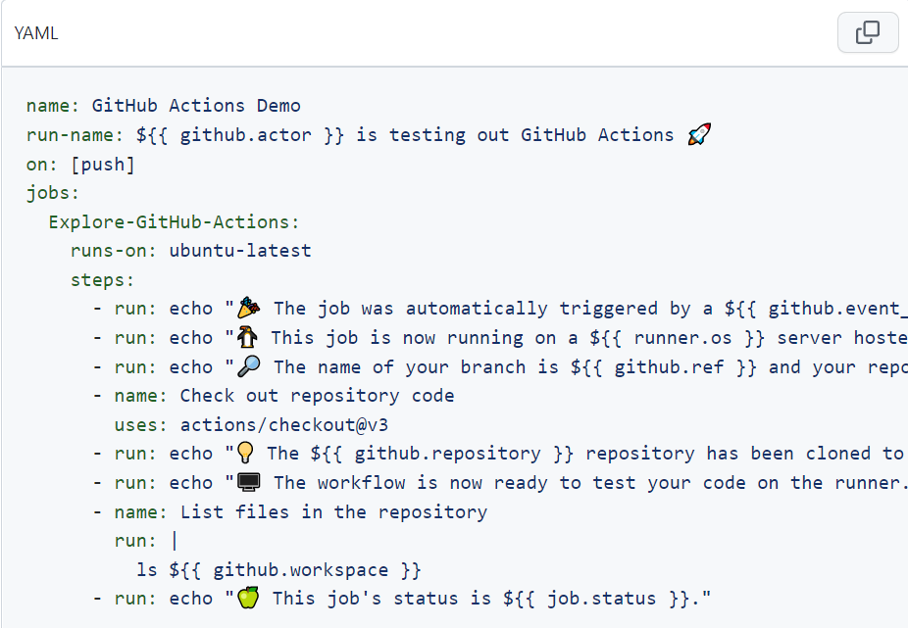
Section 5 - GitHub and Git in Practice
GitHub Actions YAML File

Slide 96
Section 5 - GitHub and Git in Practice
GitHub Actions YAML File

Slide 97
Section 5 - GitHub and Git in Practice
You can see the full syntax for the YAML files in the documentation:
https://docs.github.com/en/actions

Slide 98
Section 5
Exercise and Solution

Slide 99
Section 5 - GitHub and Git in Practice
It’s your last Section!
To celebrate, here is your challenge (for which there isn’t really a 100% solution):
Find an open source project
Fork and Clone it and then attempt to improve the documentation (or code if you’re up to it!)
Submit your pull request, and mention you are new to this in your PR!

Slide 100
Section 5 - GitHub and Git in Practice
If you still feel uncomfortable about pull requests on repo, feel free to practice on ours here:
github.com/Pierian-Data/example-for-forking
Create your own fork
Clone your fork to a local machine
Create a change, add, and commit it
Push that change to your forked repo
Submit a Pull Request

